Slide 1
SECURE DATA HIDING USING STEGANOGRAPHY
CAPSTONE PROJECT
Presented By:
Student Name : Madugundu Sailaja
College Name & Department : G. Pulla Reddy Engineering College
Computer Science and Engineering

Slide 2
OUTLINE
Problem Statement
Technology used
Wow factor
End users
Result
Conclusion
Git-hub Link
Future scope

Slide 3
Problem Statement
This project focuses on secure data hiding using steganography, where sensitive information is embedded within digital media such as images or audio. Unlike traditional encryption, steganography ensures covert communication by making hidden data undetectable to unauthorized users. The system will provide efficient encoding and decoding methods for secure message transmission. This technique is useful for cybersecurity, military intelligence, and confidential data exchange.

Slide 4
Technology used
cv2
OS
String (using ascii values)
Encryption
Decryption
IDLE(Python3.13 64-bit )

Slide 5
Wow factors
Invisible data
Dual Layer Security(Encryption)
Only authorized users can access
Multi Format support(images , audio)
Important for real world

Slide 6
End users
Army
Intelligence agencies
Defense sectors
Counter-Intelligence & Anti-Surveillance

Slide 7
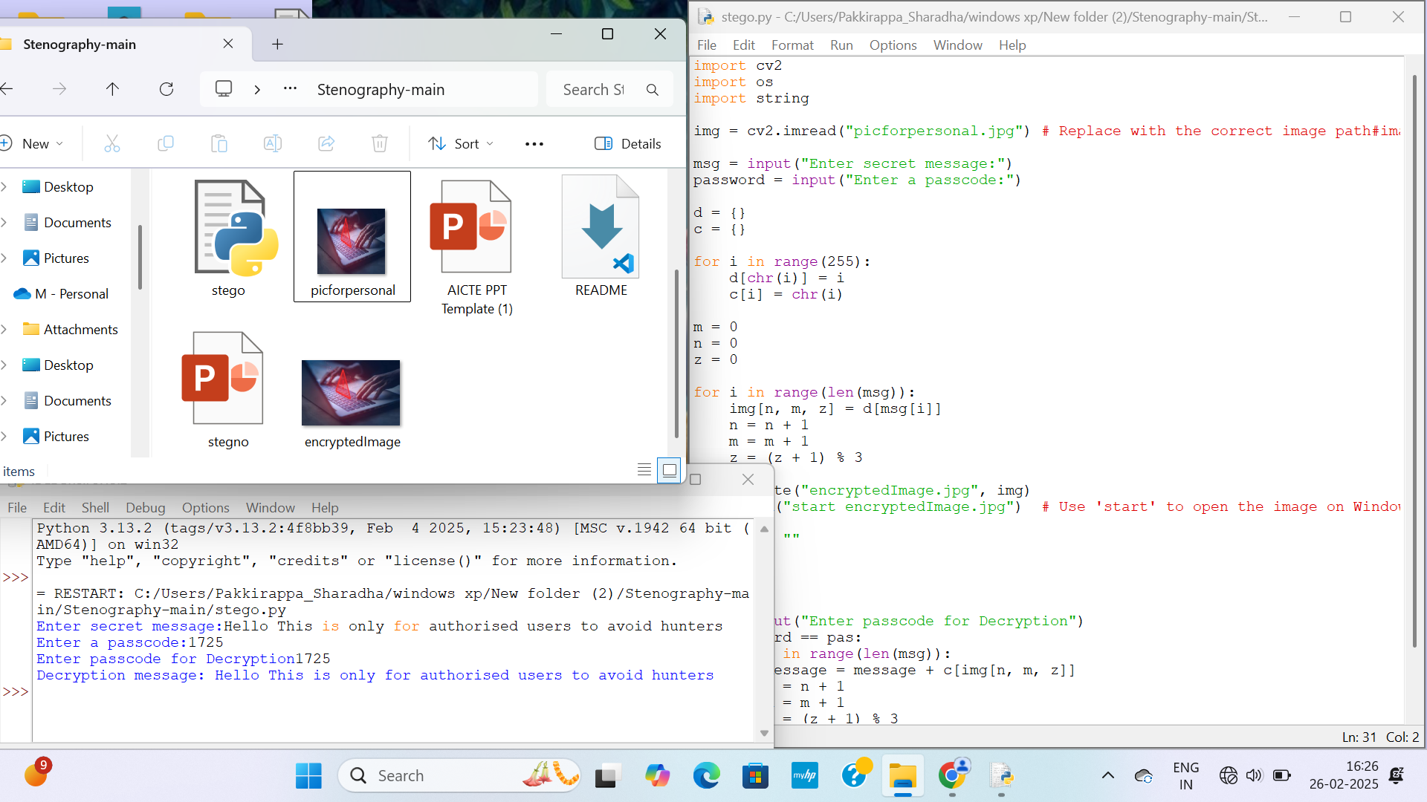
Results

Slide 8
Conclusion
This project successfully implements secure data hiding using steganography, ensuring confidential communication.
It provides an undetectable method to conceal sensitive information within digital media, enhancing privacy.
The system offers efficient encoding and decoding, ensuring accurate retrieval without data loss.
It has real-world applications in cybersecurity, military intelligence, and secure messaging.
By combining steganography with encryption, the project strengthens data security against unauthorized access.

Slide 9
GitHub Link
https://github.com/Sailaja-25/Steganography

Slide 10
THANK YOU

